Slide 1
Urdu.h
A Custom C Library
By CodeMasters

Slide 2
Contents.
Why Urdu.h?
What is a Library?
What are Functions?
Its Use in Our Project
List of Functions in Urdu.h
What are Macros?
Its Use in Our Project
List of Macros in Urdu.h
Output Examples
Explanation of the Code
Demo
The Tools We Used

Slide 3
Why Urdu.h?
Standard C can be a bit intimidating for beginners, so we decided to build something unique and useful; a library that’s fun to use and intuitive for Urdu speakers.
What does it do?
Urdu.h is a header-only library that:
1. It uses macros to translate standard C keywords into Roman Urdu (like #define agr if).
2. Simplifies pre-built functions for common tasks (e.g., parhle handles input in one line).
3. Removes the need to memorize format specifiers (%d, %s, etc.).

Slide 4



What is a Library?
Its a pre-written collection of functions and code that you can include in your program to perform specific tasks
“Stdio.h” is an example of a library in C.
Why use a Library?
Libraries help reduce development time and enhance reusability of code

Slide 5

Did you know?
C itself has no built-in input/output operations or other common functions, they are all defined in libraries.
What are Functions?
Function is a self-contained block of code designed to perform a specific task.
Functions are fundamental to modular programming, allowing developers to break down complex programs into smaller, more manageable, and reusable units.

Slide 6
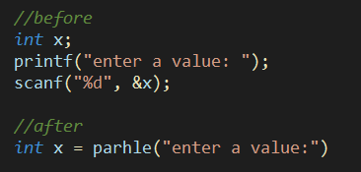
Use of Functions
We used functions to define and modify predefined functions present in C.
The efficiency, in some cases, increased due to our modifications.
In C, the usual input taking would be around 3 lines of code. In Urdu.h, it reduces to just one. Thus, increasing the efficiency.

Slide 7
List of all the Functions
toupper() - bara_karo()
tolower() - chhota_karo()
isdigit() - kya_adad()
isalpha() - kya_harf()
isalnum() - kya_harfya_adad()
fopen() - file_kholo()
fclose() - file_band()
fprintf() - file_likho()
printf() - likhde()
scanf() - parhle()
puts() - likhde_line()
putchar() - likhde_harf()
strcat() - jodo()
strcpy() - nakal()
strcmp() - muqabla()
strlen() - lambai()
continued…

Slide 8
List of all the Functions
fscanf() - file_lo()
fgets() - line_lo()
fputs() - line_likho()
time() - abhi_ka_time(), abhi_ka_wakt(), aaj_ki_tareekh()
sleep loop - ruk_jana()
ctime() - likhde_abhi_ka_time()

Slide 9
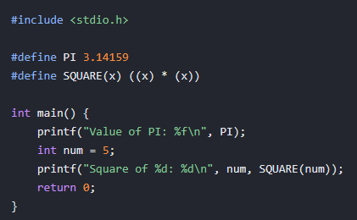
What are Macros?
Macros are symbolic names or fragments of code defined using the #define preprocessor directive.
They are essentially text substitutions that the preprocessor performs before the actual compilation process begins.
For example, in the above program, ‘PI’ is defined as 3.14159. The square of a number is also defined.
Whenever the defined arguments appear in the program, they are replaced with their defined values or expressions.

Slide 10
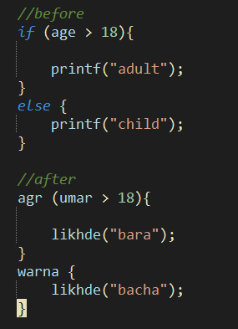
Use of Macros
We used Macros to define/change the names of certain functions C language already has.
The use of Macros was adopted in places where functions would be inefficient.

Slide 11
List of all the Macros
agr - if
warna - else
warna_agr - else if
badal - switch
surat - case
warna_sab - default
jab_tak - while
karo - do
agay_chalo - continue
ruk_jao - break
file_kholo - fopen
file_lo - fscanf
bara_karo - toupper
chota_karo - tolower

Slide 12
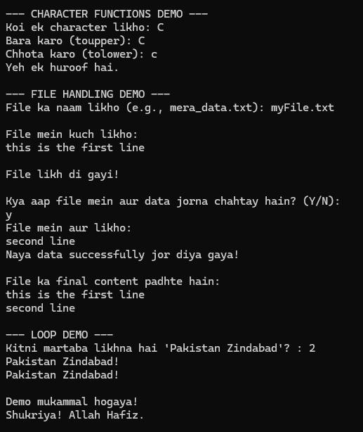
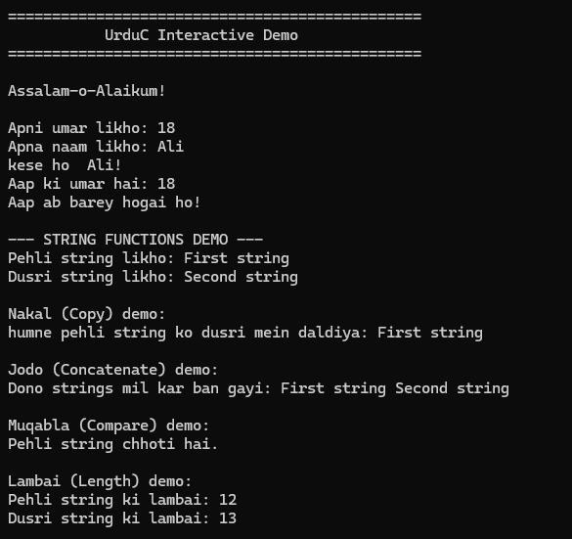
Output Examples

Slide 13
The Tools We Used
These tools made our library easy to manage and code.
VS Code
To code the header file and the demo.
AI
To clarify queries on fundamental programming concepts.
Doxygen
To create a complete, professional documentation of the project.

Slide 14

Thank You!
Take a look at our project and try urdu.h yourself!

